Slide 1
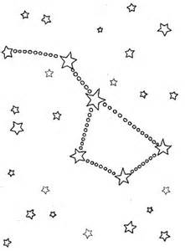
Star Clocks
Name: Shaylee Berheim
Age: 18 years old
4-H Years: 11 years
Project Age: 5 year
4-H Club: Down On The Farm
Leaders: Roxanne Berheim &
Mike Berheim

Slide 2
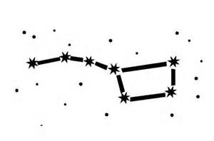
STAR CLOCK
Are the stars spinning, or is it just you? Discover how the spinning Earth changes the way we see stars. If you’re a stargazer (or an aspiring one), this science fair project will help you create a star clock that uses the stars to determine what time it is on earth!

Slide 3
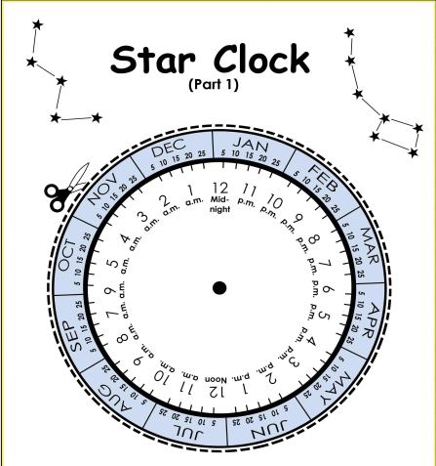
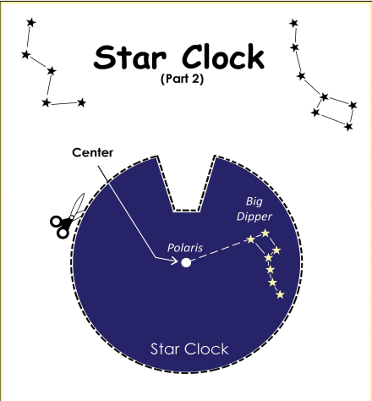
STAR CLOCK MATERIALS NEEDED
Two 8 ½ x 11” sheets of cardstock paper that can go through a printer
Paper fastener
Scissors
Printer
Watch

Slide 4
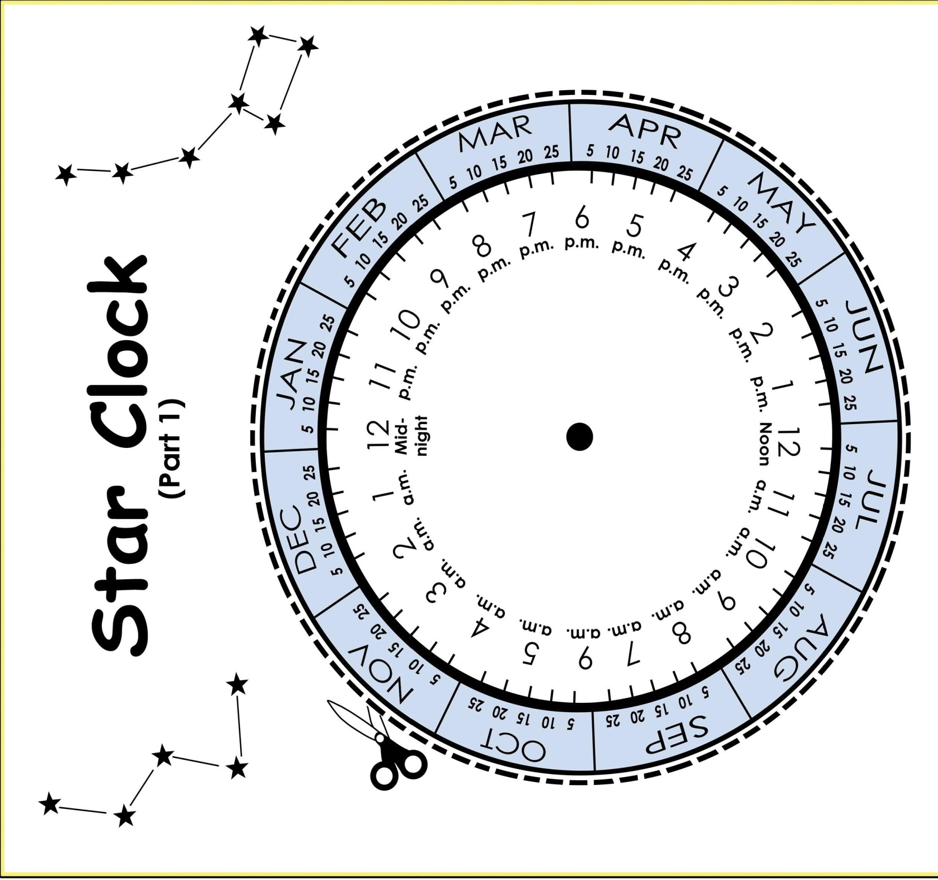

Slide 6
STAR CLOCK PROCEDURES
Print this two-page worksheet on your cardstock paper.
Cut out the white disk and the black disk. Attach them in the center with a paper fastener or brad. This central point represents the North Star, Polaris.

Slide 7
STAR CLOCK PROCEDURES
Choose a clear night, and find the North Star in the sky. Face the North Star. Move the lighter circle so that you have the current month at the top.

Slide 8
STAR CLOCK PROCEDURES
Now, look for the Big Dipper. It should look like a big ladle in the sky. Move the smaller, darker circle around until it lines up with the positions of the big dipper’s stars.

Slide 9
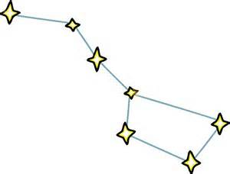
STAR CLOCK PROCEDURES
What time do you see highlighted in the gap in the black circle? Check your watch. This should be close to the current time. If you are on daylight savings time, you will need to add one hour to the time. Did your star clock work? How well did it work?

Slide 10
STAR CLOCK RESULTS
You will be able to tell the time by moving the star clock around to the current month and lining it up with the stars in the sky.
Why?
Do the stars themselves move?

Slide 11
STAR CLOCK RESULTS
You probably know that the rotation of the Earth makes it sunny for about half the day and dark for the other half. Of course, the amount of light and darkness depends on the time of the year. Day and night happen because the Earth rotates on an axis that runs through the north and south poles. Sometimes the part of the earth you’re standing on faces the sun, and sometimes it doesn’t. This is why the sun appears to rise and set—but the sun isn’t actually moving.

Slide 12
STAR CLOCK RESULTS
Now, let’s talk about what happens in the night sky! The same apparent motion happens to the stars at night. The earth spins, and this makes the stars appear to move from east to west in what is called a diurnal circle—the apparent (not real) movement of the stars around the earth. For example, the Big Dipper constellation appears to move around the poles in what’s called circumpolar motion. If you watch long enough, the constellation will seem to travel around Polaris, the North Star. Exactly where the constellations appear to be in the sky depends on your latitude, or how far north or south you are on the earth.

